Slide 1
UMLC 2020 x Blockchain Interim Presentation
GIST College, 7th Semester
School of EECS
Suwhoan Lim (임수환)

Slide 2
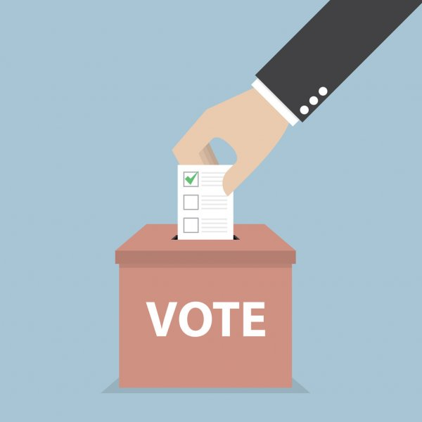
Table of Contents
Research Topic
Background Knowledge
Secret Sharing Scheme
Roadmap
What I have done
What I will be working on
Notes:
Restate the research topic.
Explain why we need this, why we need blockchain in an e-voting scheme and why we need this secreting sharing scheme in the protocol.
What is secret sharing scheme and how it works
I have preparid today’s presentation to give you more background information about what this is all about.

Slide 3
1. Research Topic
Python-Solidity interaction via web3py python library - Implementation of Shamir's Secret Sharing Scheme
Blockchain Voting – In terms of Confidentiality and Security
Notes:
It’s quite niche. In a bigger picture, I am trying to implement a blockchain voting scheme focused on confidentiality and security. Let’s look at how it works out.

Slide 4
2.1 Traditional Voting Scheme
1. Bob receives a plane ballot
2. Without showing anyone, Bob put a marker next to the option he wants to choose.
3. Bob puts his ballot into a secure, protected box/volt
4. Finished!
… Or is it?
Notes:
Picture a Korean president election if you may.
If we are just a plane voter, then this might be it. But what we really need to look at is the things that are going behind the scene.

Slide 5

2.1 Traditional Voting Scheme
5. Ballots are collected and taken to one place for counting
Trusted Third Party
6. Ballots are counted either by hand or machine
Its existence may sabotage the voting process!
7. Results are recorded & announced to the public
Notes:
What if the ttp goes rogue, gets corrupted, and doesn’t follow the rules correctly?
There is a group of people doing all those work. By trusting this group, we can get much of the hassle done by removing repeated works and overall trust the validty of the voting system.

Slide 6
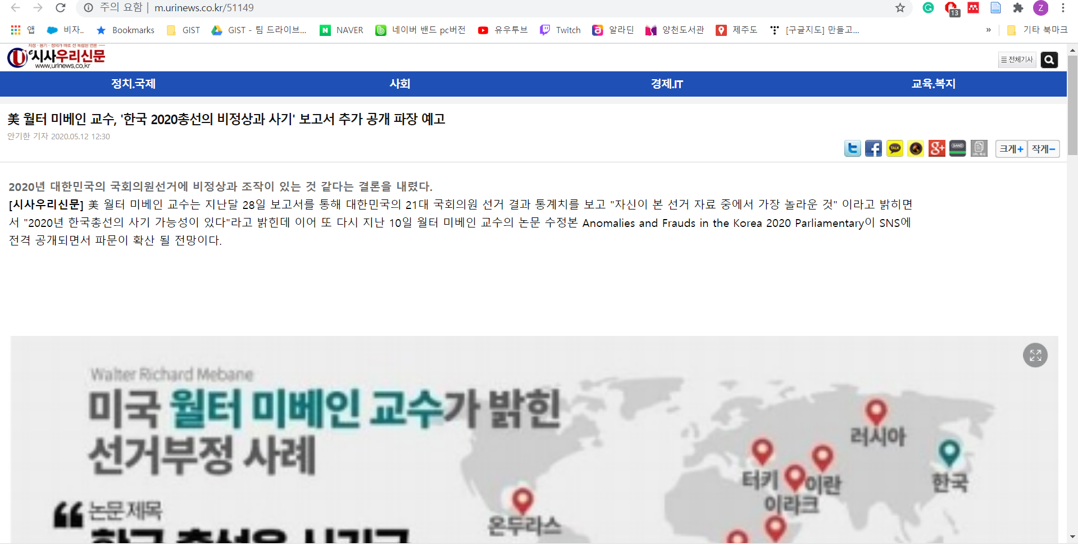
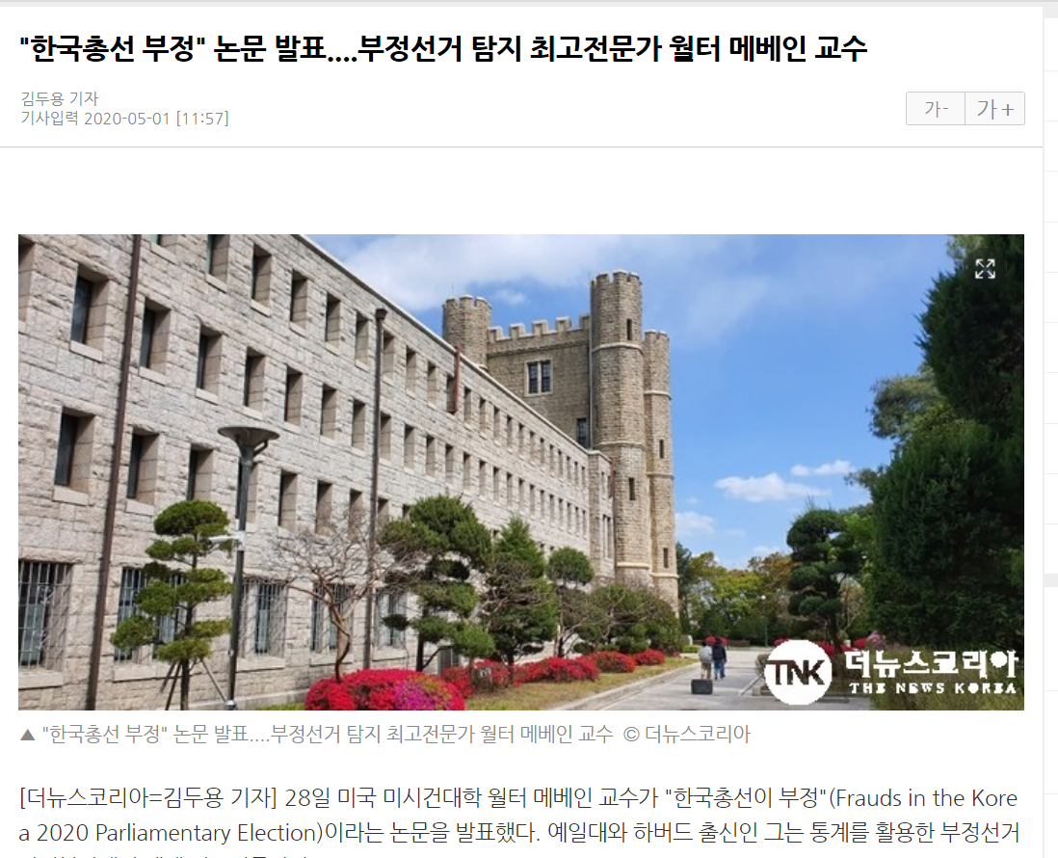
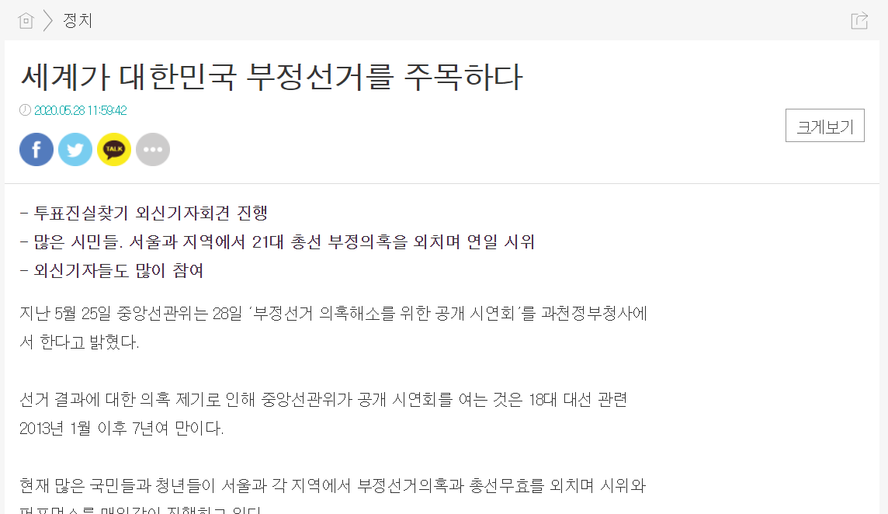
2.1 Traditional Voting Scheme
Notes:
This is an example of people not trusting the ttp
If I have doubt, yeah, I can ask them to reopen all the ballots and count them by myself.
Even if I’m satisfied with the result, say someone else comes and say they can’t trust the result, and they recount the ballots… you see what I mean.
Maybe consider removing this slide?
Even the party was honest after all, there is always a suspicion that the party is not honest
This is one possible argument you can make about an election being a fraud

Slide 7
2.2 To get rid of the TTP…
Problem:
Voting data can be fabricated
Solution:
Let’s store data on a blockchain
Immutable
Public
Transparent
Decentralized
Blockchain can replace the position of a TTP!
Notes:
By having all the participants to share this electronic ledger and monitor the block mining process, transactions, etc, we can remove the need of the trusted party. The network will be the trusted party

Slide 8
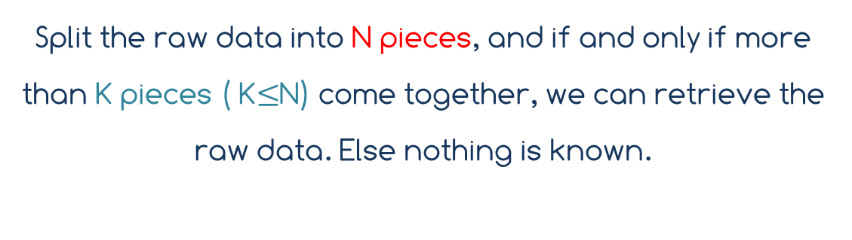
2.3 How to securely store the data?
Split the raw data into N pieces, and if and only if more than K pieces ( K$≤$N) come together, we can retrieve the raw data. Else nothing is known.
Shamir’s Secret Sharing Scheme.
Problem 2:
Blockchain is public (Everyone can access the data)
Solution 2:
Encrypt the data before sending it to the blockchain
Notes:
We want to do something to the raw data before sending it to the blockchain server so that the results are stored intact before the counting begins.
Raw data being an integer

Slide 9
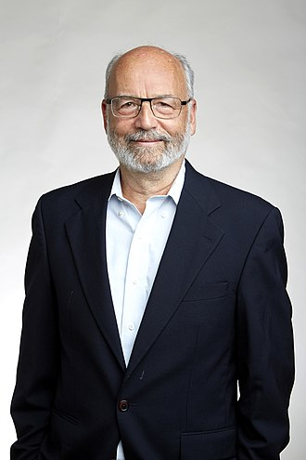
3.1 Shamir’s Secret Sharing Scheme
Adi Shamir (1952 ~ )
Israel Cryptographer
Developer of RSA Algorithm (1977)
(Rivest–Shamir–Adleman)
Notes:
The brains of the era

Slide 10
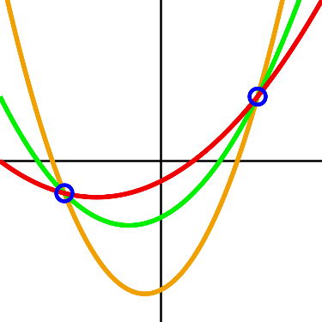
3.1 Shamir’s Secret Sharing Scheme
Axiom 1: There exists one and only one degree n polynomial that goes through n+1 distinct points
Axiom 2: Given n+1 points, one can find an unique degree n polynomial
Corollary 1: Given less than n+1 points, one gets no information about the degree n polynomial
Notes:
Term axiom is not stricktly a mathematical term but just used to show its significance

Slide 11
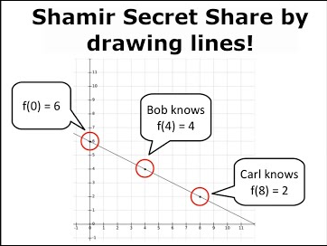
3.1 Shamir’s Secret Sharing Scheme
1. Set the secret on (0, y)
3. Find n+1 points on the function f
2. Find a degree n polynomial f
4. Distribute n+1 points to n+1 people
Notes:
Term axiom is not stricktly a mathematical term but just used to show its significance

Slide 12
3.1 Shamir’s Secret Sharing Scheme
1. Collect n+1 points
2. Find the function f using Lagrange Interpolation
3. Find f(0) = y
Notes:
The ballots were not be able to collected , not counted, not recorded properly, and therefore we cannot trust its validity.
And blockchain was introduced to this e-voting scheme as an effort to solve this particular issue regarding the ttp

Slide 13
3.2 Why do we need a such scheme?
We do not wish to put the raw data on the blockchain – Everyone can see it!
Break the secret into piece and the upload it, so that additional measure is needed when trying to decode the secret
Do the heavy work in python / local machine & only upload the result to the Blockchain
-> Cost efficient (In terms of Computing Power)
-> Scalable (More data can be stored in a block)

Slide 14
4. Roadmap
1. Reference Analysis
2. Python implementation of SSS
3. Smart Contract written in Solidity for Python-Ethereum interaction
4. Web3py library implementation
So far done
To do
Notes:
I wish to tell you more about the result, math behind it, and the program itself at the final presentation

Slide 15
Thank You For Your Attention

